Slide 1
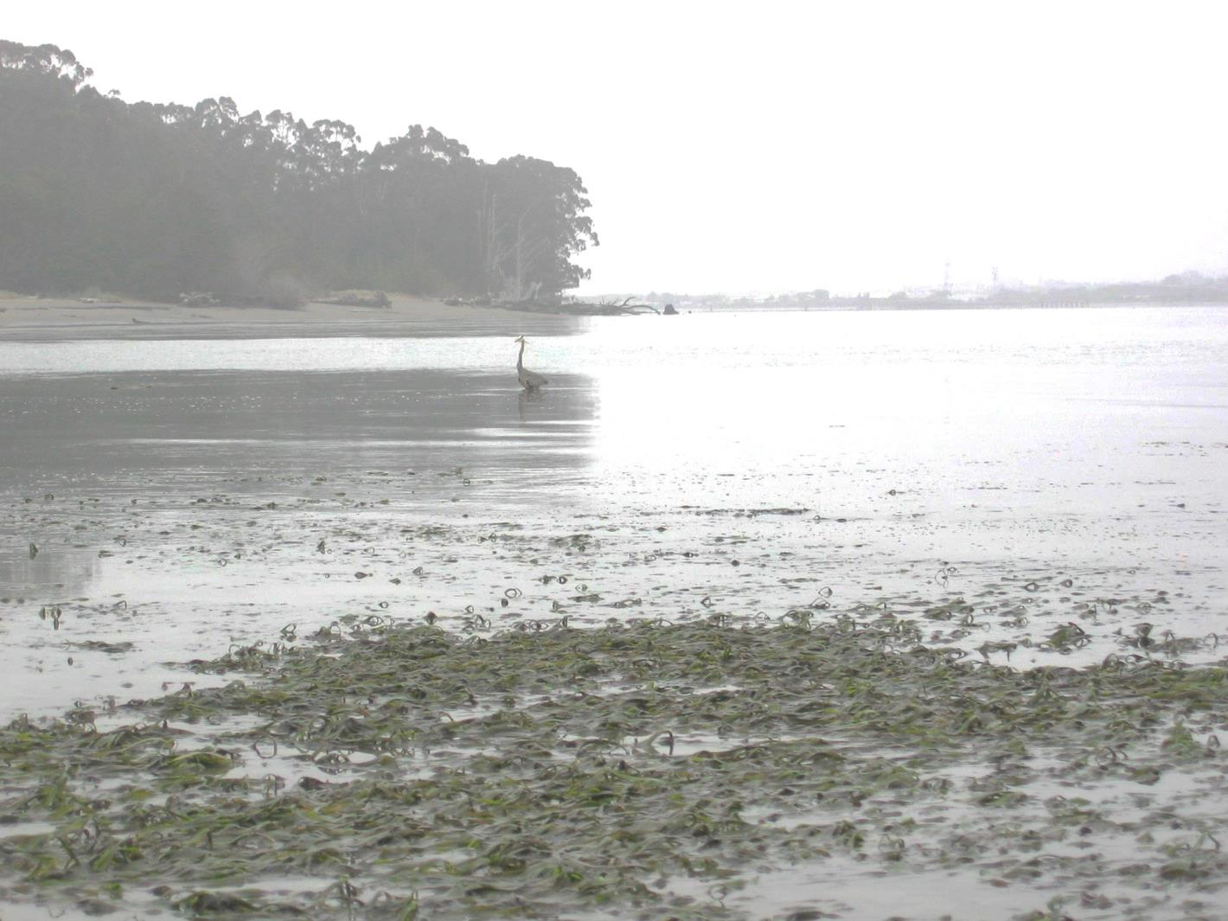
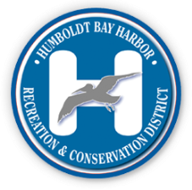
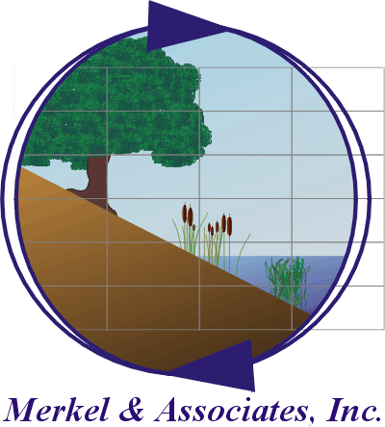

Humboldt Bay Eelgrass Management Plan:
Collaborative Partner Meetings & Plan Development Process
Humboldt Bay Harbor, Recreation and Conservation District

Slide 2
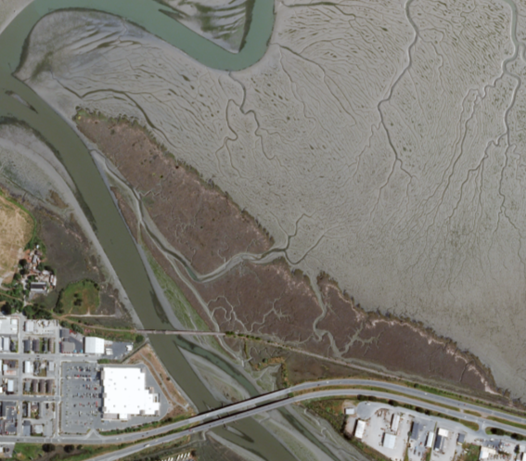
Outline
Project background
Humboldt Bay’s eelgrass in a broader context
EMP development process overview
Progress to date
Project timeline and meeting schedule

Slide 3
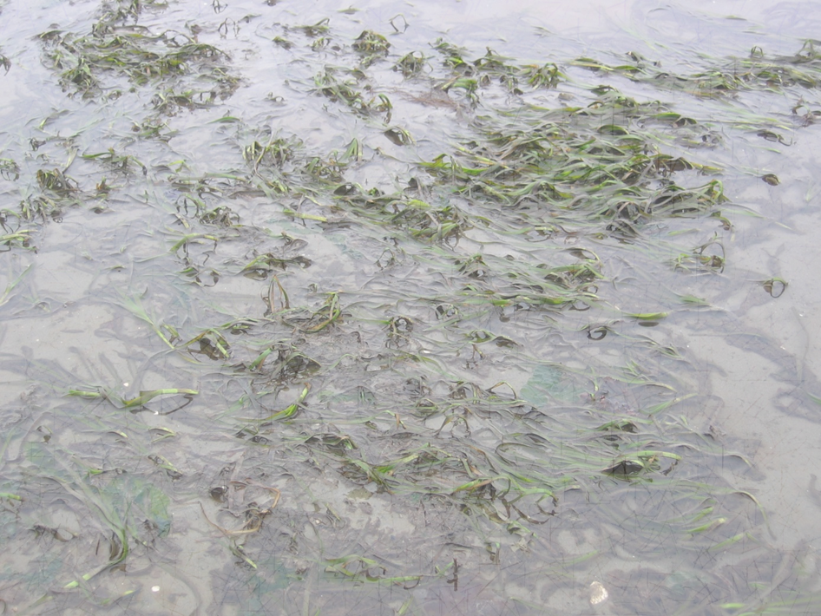
Background
Eelgrass Management Workshop (Oct 2014)
EPA Regional Wetlands Program Development Grant (Sept 2015)
Goals:
A) Develop a multi-agency management plan with consistent goals and strategies for restoration/conservation of eelgrass habitat
B) Improve efficiency of regulatory process for projects in Humboldt Bay
C) Establish long-term conservation strategy that allows for SLR adaptation, dredging, and economic development in Humboldt Bay

Slide 4
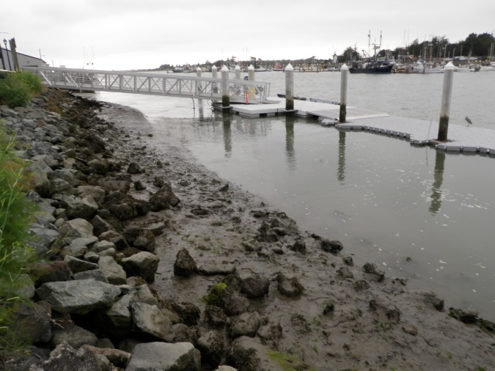
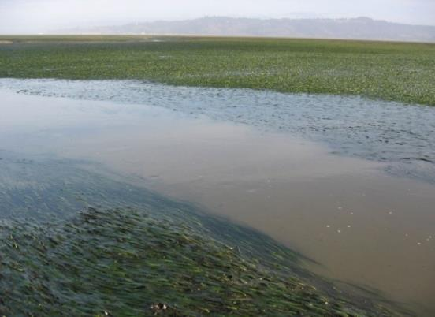
Putting the plan in a broader context
Humboldt Bay…
Contains 30-35% of California’s eelgrass habitat
Is the only system in CA presently projected to support expansion of eelgrass habitat with SLR
Is believed to be close to carrying capacity, making mitigation more challenging

Slide 5
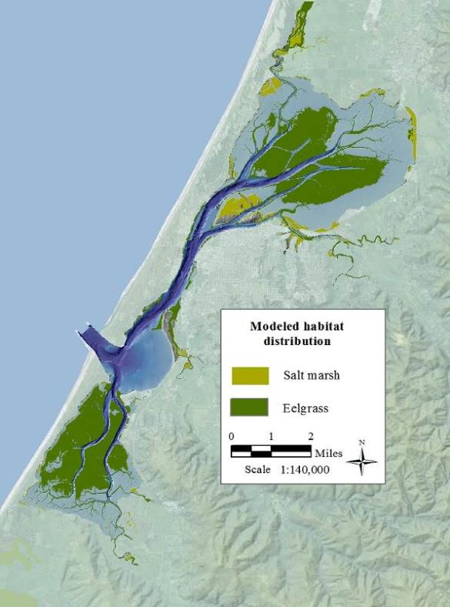
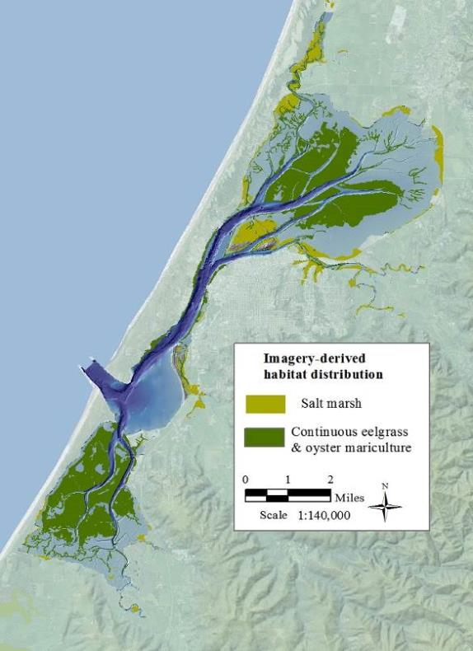
Modeled vs Imagery Derived Habitat Distributions
(Gilkerson 2013)
(NOAA 2009)
Notes:
Take home message:-eelgrass is occupying the majority of its available habitat in Humboldt Bay

Slide 6
“Moderate” Eustatic Sea Level Rise Projection (NRC, 2012)
Current ESLR rate ~2.3 mm/yr Pacific Ocean (Burgette and Weldon, 2009)
NRC projection = 9.9 cm by 2030, 21.4 cm by 2050, and 75.1 cm by 2100

Slide 7
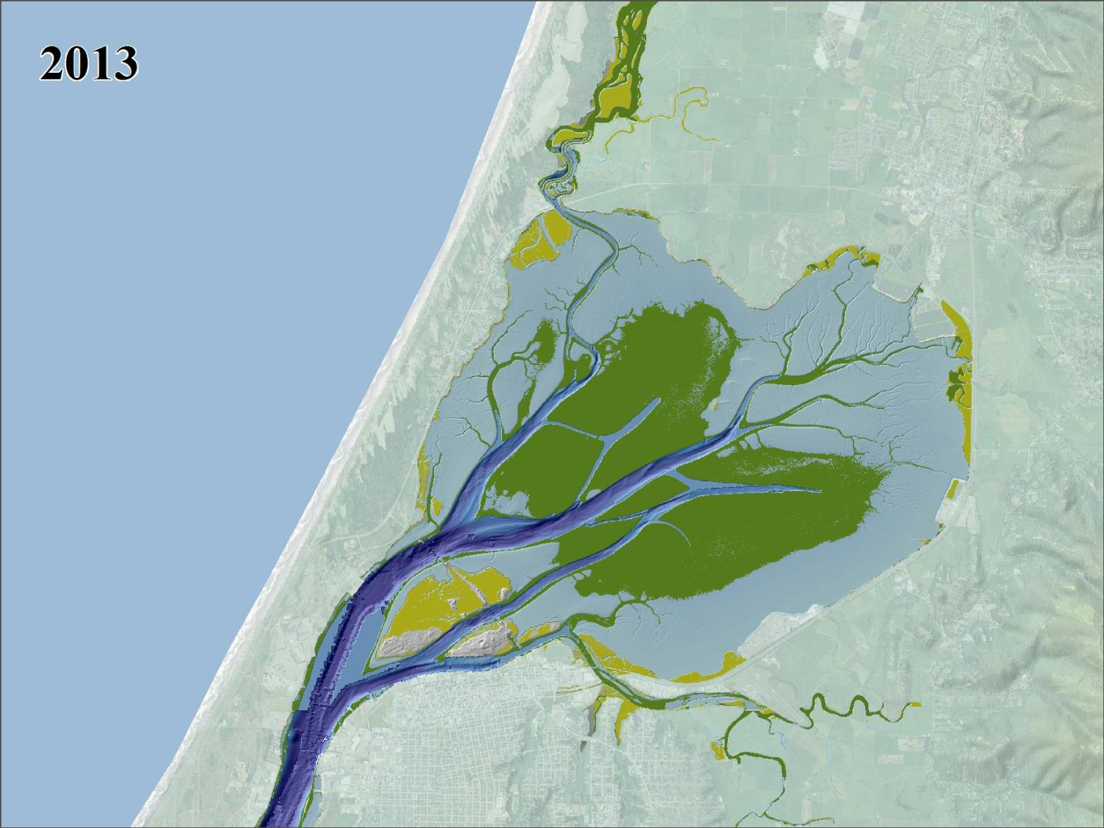
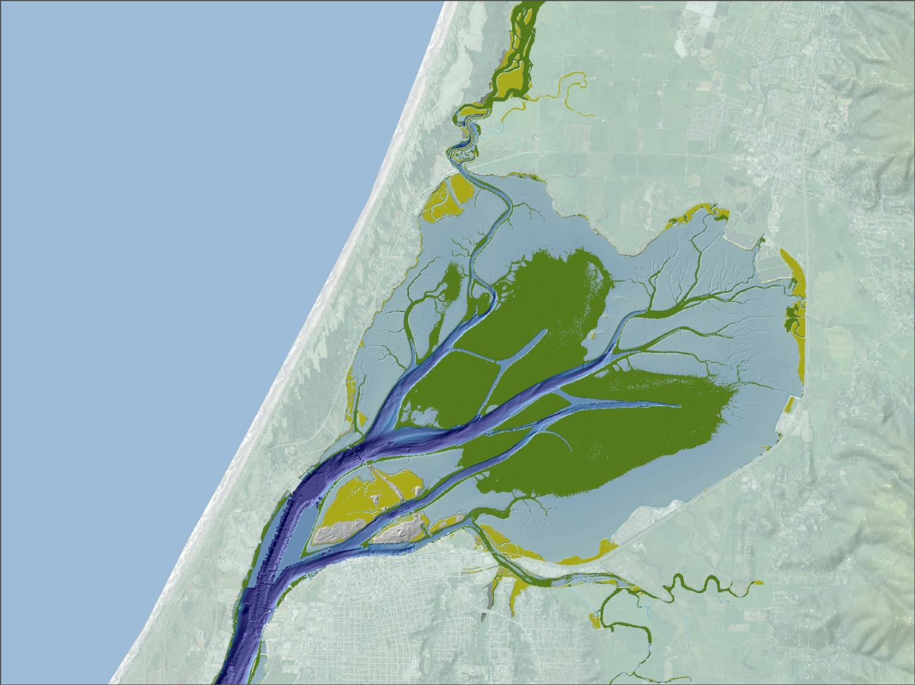
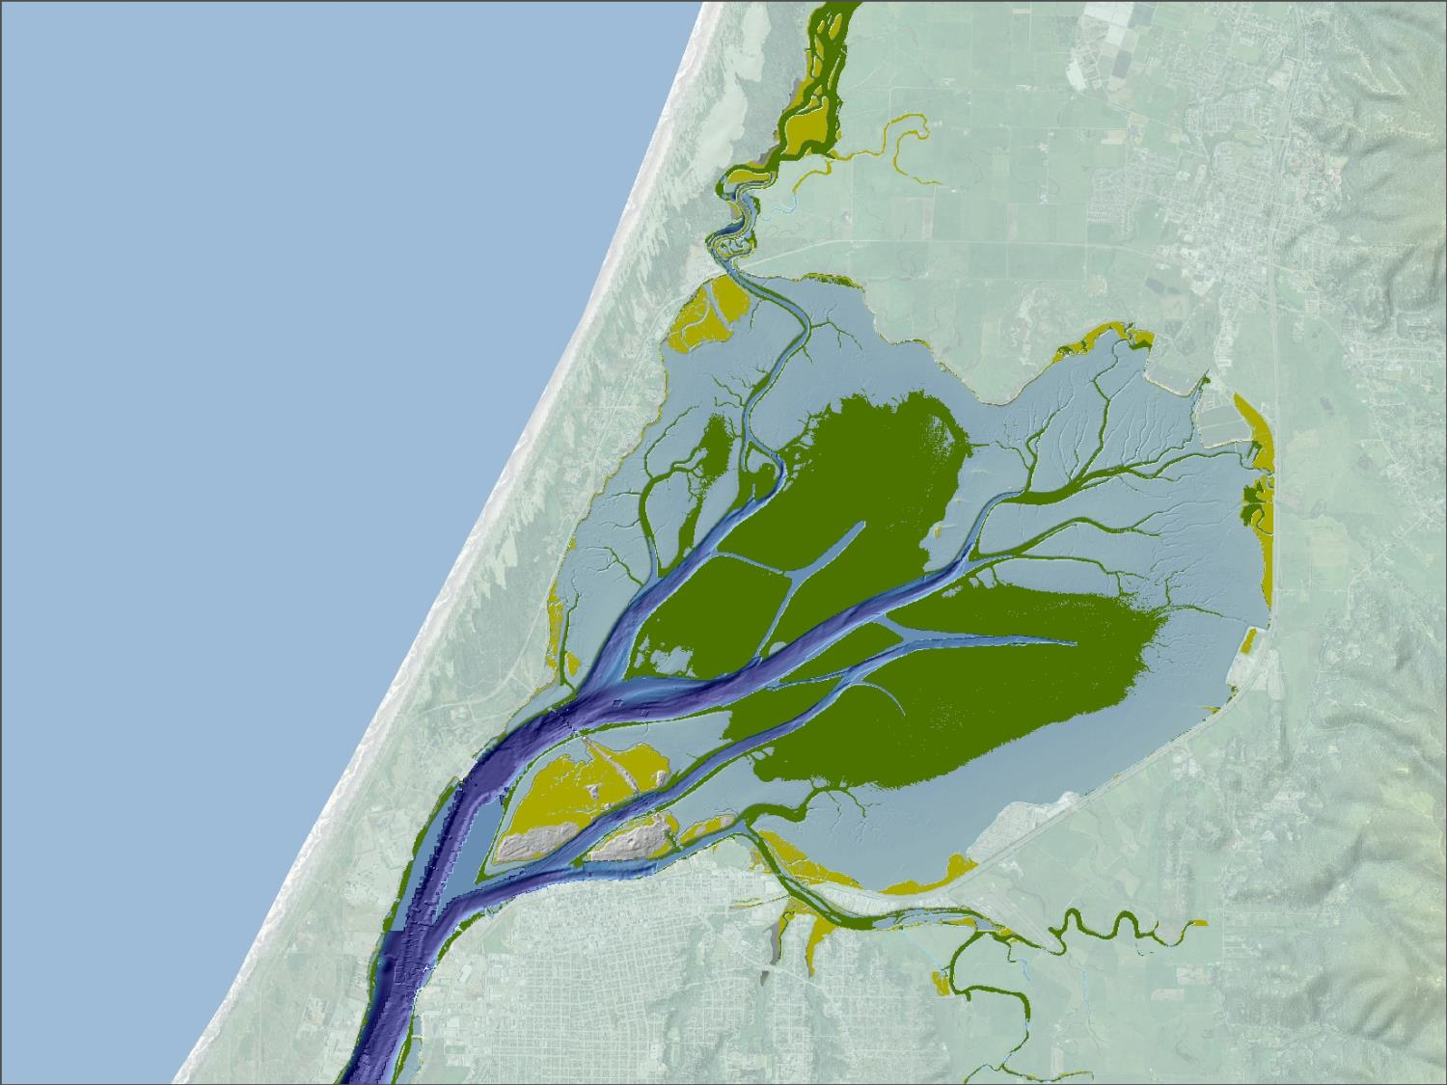


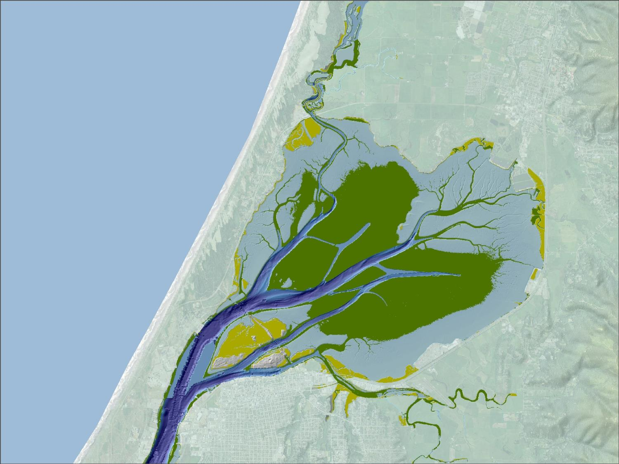
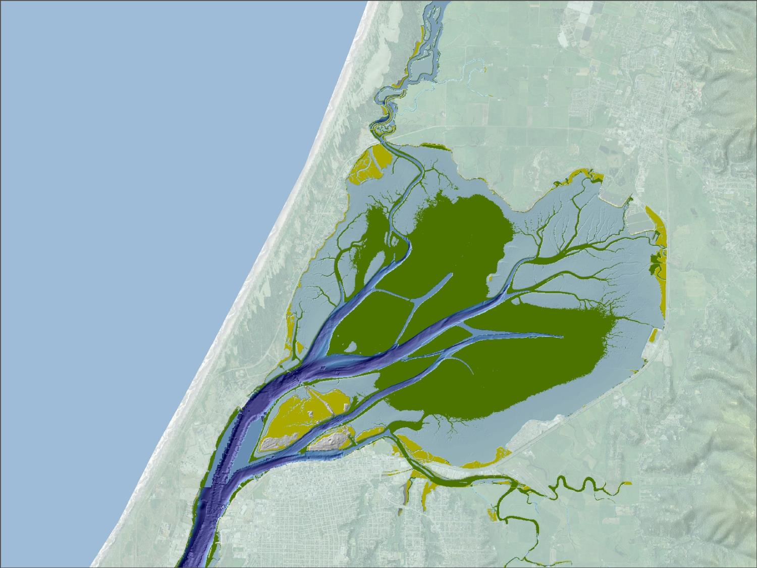
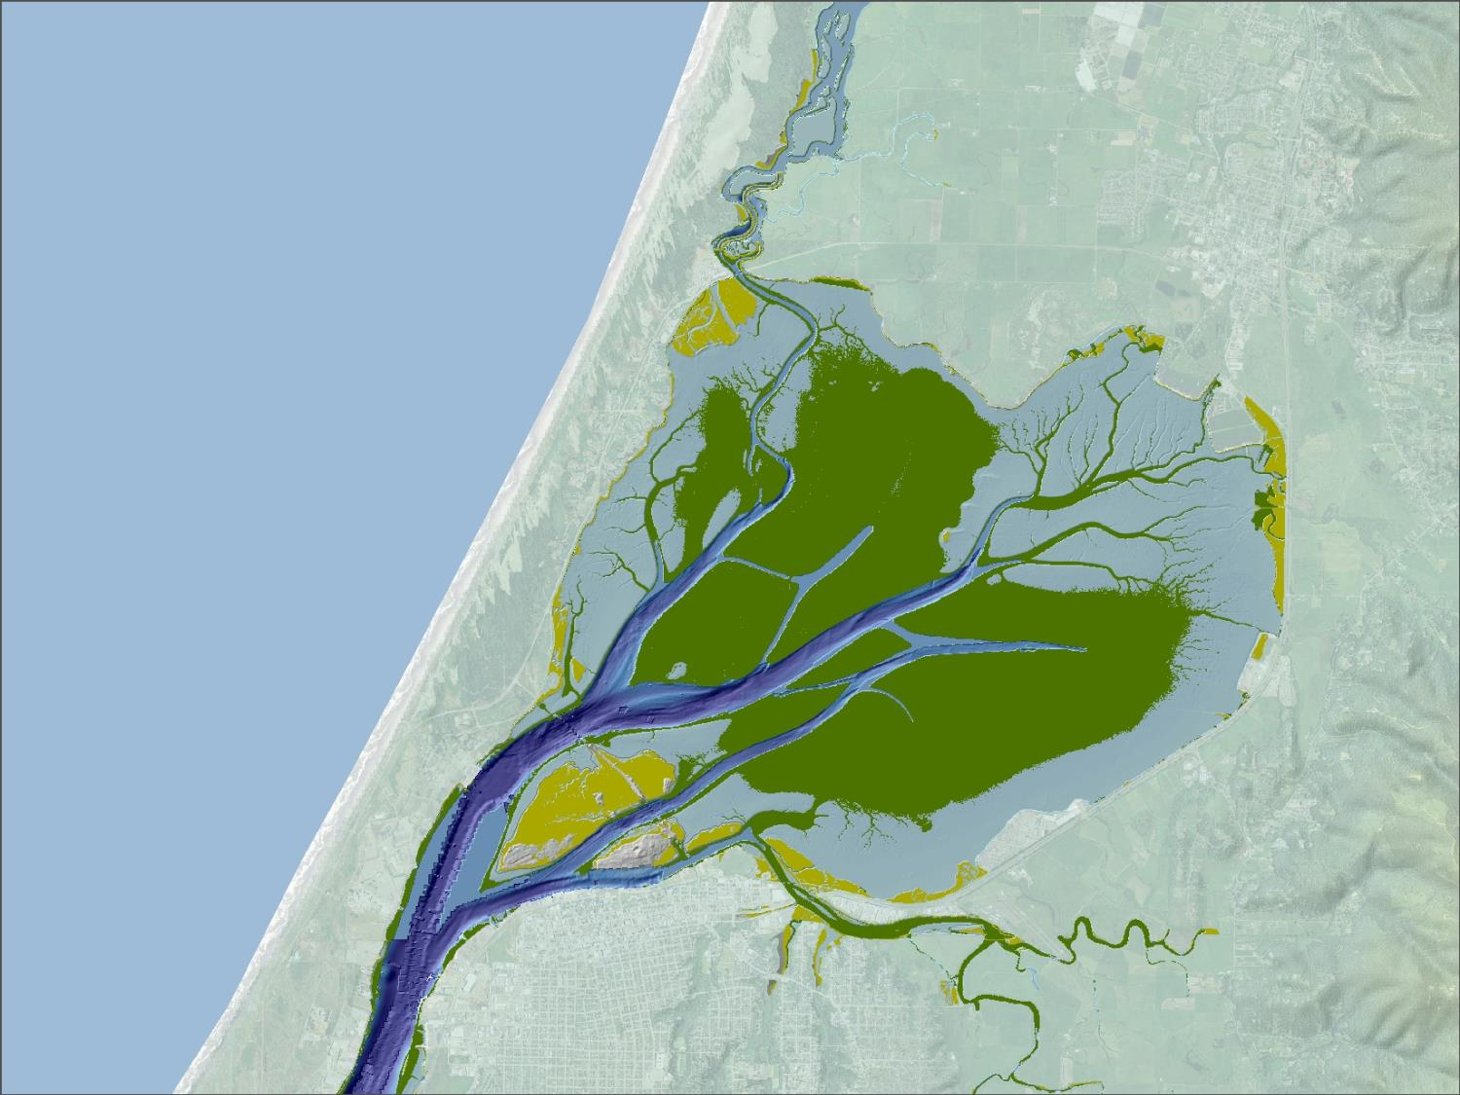

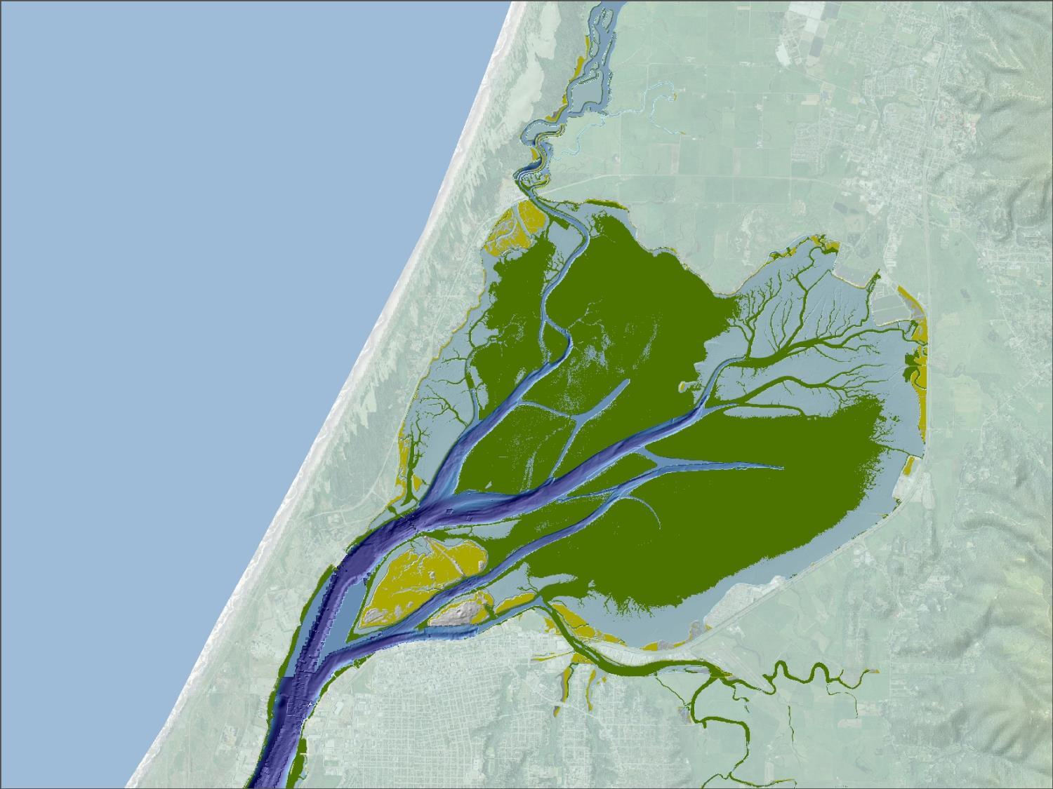
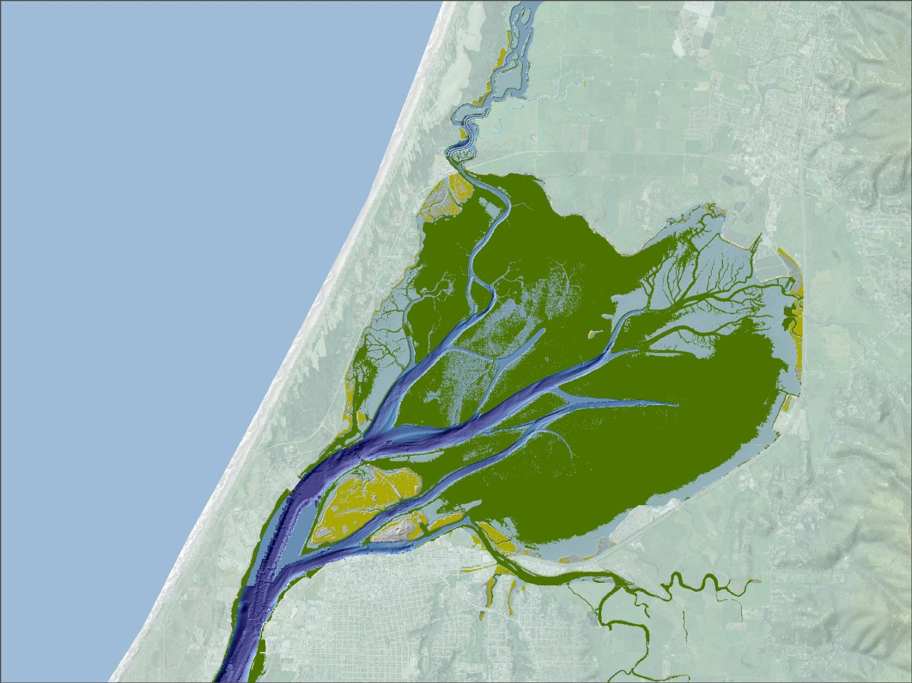
2063
2113
Notes:
This

Slide 8
North Bay Model Results
2013 Eelgrass (Ha)=1405
Salt marsh (Ha)=298
2063 Eelgrass (Ha)=1610 % change=15
Salt marsh (Ha)=296 % change=-1
2113 Eelgrass (Ha)=2447 % change=74
Salt marsh (Ha)=187 % change=-37

Slide 9
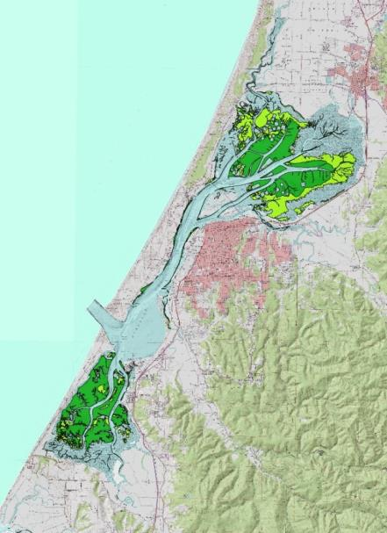
EMP Development Process Overview and (roles)
1) 5 Collaborative project partner meetings –Fall 2016-Spring 2017
(Harbor District, Merkel & Associates, and project partners)
2) 2 Public Workshops
(Harbor District, Merkel & Associates, and project partners*)
3) Develop eelgrass restoration/protection goals
(Harbor District, Merkel & Associates, and project partners)
4) Conduct bay tours to evaluate restoration/mitigation opportunities
(Harbor District, Merkel & Associates, and project partners)
5) Baseline data/directed research
(Merkel & Associates)
6) Evaluate Regulatory Context, Cost Recovery & Monitoring
(Harbor District, Merkel & Associates, and project partners)
7) Develop 2 drafts and final plan incorporating partner input
(Merkel & Associates, Project partners, Harbor District)
8) Develop project webpage-Plan support, communication and project tracking
(Harbor District)
* We encourage project partner and stakeholder involvement in the Final Public Workshop and presentation of the Plan.
Humboldt Bay and Eel River Estuary Benthic Habitat Project, Eelgrass habitat data, 2009.

Slide 10
Plan Development Components
Policies and Values Elements
Regulatory Context, Cost Recovery & Monitoring
Technical Components

Slide 11
      Policy Elements
Determine Plan priority/focus areas (HD, Humbolt Co., municipalities)
Develop up front criteria for eelgrass surveying and/or mitigation planning requirements
Identify eelgrass conservation/protection priorities/locations (input from public, tribes, other stakeholders)
Establish restoration/mitigation priorities
Address temporary (recurring) vs permanent impacts to eelgrass relative to mitigation requirements
Consider current vs future eelgrass distribution relating to climate change & SLR

Slide 12
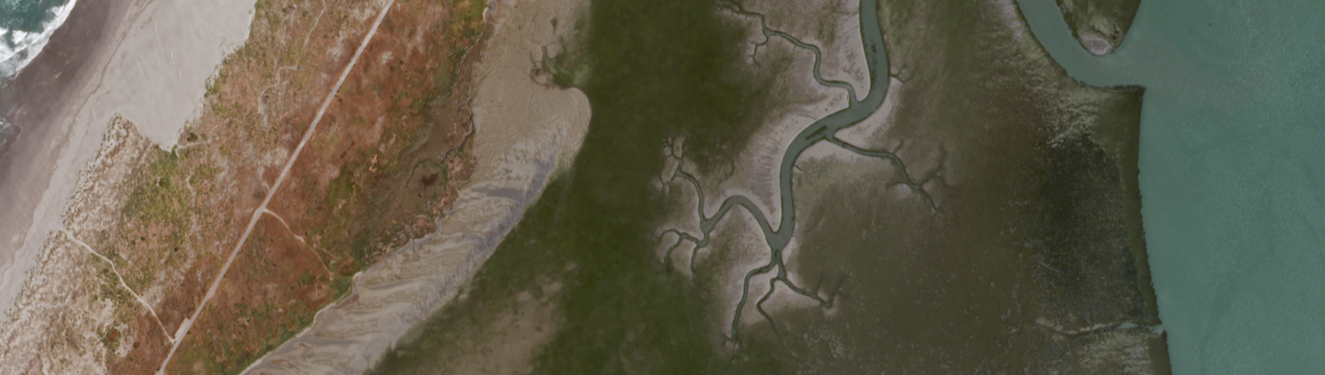
      Technical Components
Appropriate mapping and impact assessment methodologies
Anticipating and evaluating direct and indirect impacts from projects
Addressing bathymetry, circulation, and other project-specific data needs
Evaluate active (e.g. transplant) vs passive (e.g. piling removal, Salt marsh restoration) mitigation approach (strategies, relative costs, consistency with conservation priorities and other bay uses) and potential mitigation opportunities
Mitigation site development, transplanting considerations, onsite vs offsite mitigation (based on impact threshold, project site capacity, etc.), potential for banking credits

Slide 13
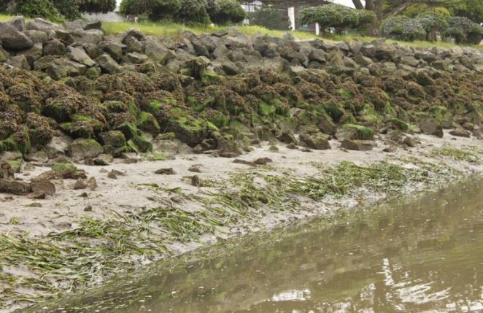
      CMP, Programmatic Permitting,
      Cost Recovery, & Monitoring
      Understanding and aligning state and federal permitting requirements and options
      Exploring Regional General Permit and/or other programmatic permitting tools
      Evaluating mitigation bank development, in lieu fee program, or hybrid approach
      Develop framework for long-term eelgrass monitoring program in Humboldt Bay
      *Implementing some of these components may be beyond the initial scope of the Plan.

Slide 14
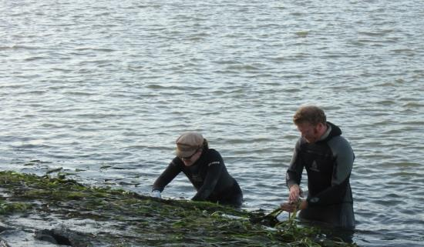
Opportunities for Plan Expansion?
Recent state legislation: SB 1363 supports actions to combat ocean acidification :
Promotes protection and restoration of eelgrass habitat
Provides for funding to support adaptive management, planning, coordination, monitoring, research, and other necessary activities to minimize the adverse impacts of climate change.
Plan adoption/support-
Help leverage funding for
future implementation

Slide 15
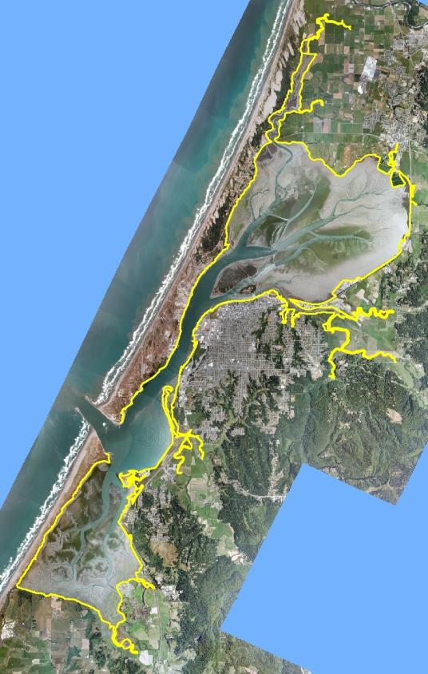
EMP Plan Coverage and Focus
Humboldt Bay-importance of understanding eelgrass resources in a system context, population variability, conservation/mitigation opportunities, climate change/SLR
Plan Emphasis-address developed ‘core’ use area of the bay, small incremental/recurring impacts w/ focus on maintenance activities (e.g. dredging channels and public launch facilities), guidance for redevelopment & new construction activities along working waterfront
Regulatory subcomponent- Improve efficiency and consistency in application of eelgrass regulatory policy-Mechanism for coordination
Imagery: NOAA 2009
Shoreline: Aldaron Laird 2014

Slide 16
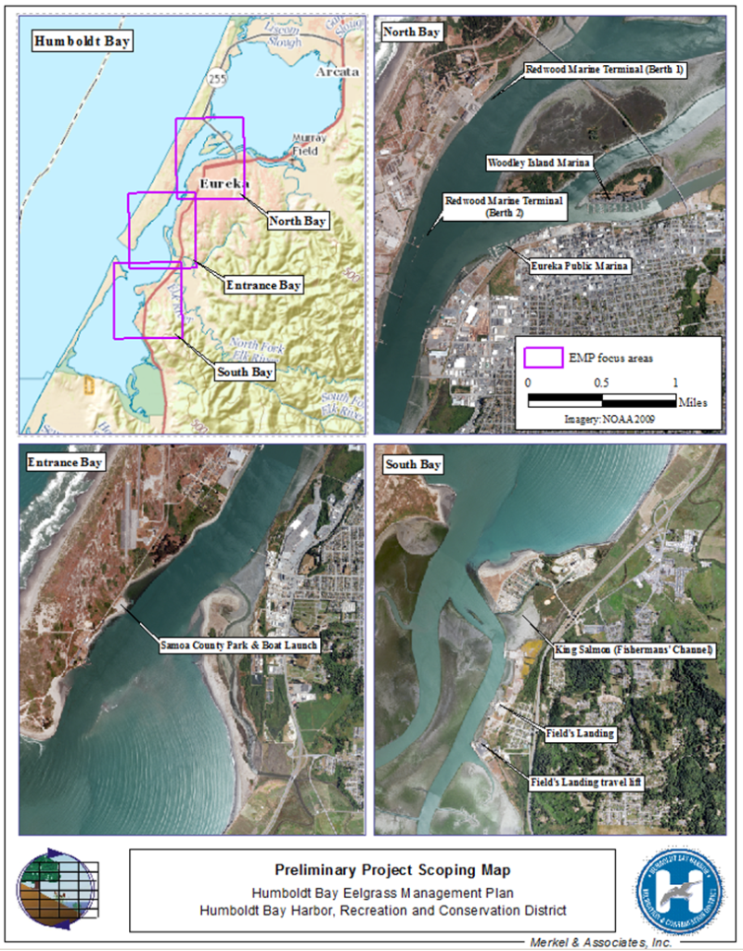
Preliminary Focus Areas
Samoa, Fairhaven and Eureka’s working waterfront
Entrance Bay/North Bay Channel
King Salmon and Fields Landing
High priority maintenance projects within Focus area of Plan (case studies) –Advance policy, technical, and regulatory sub-components of the Plan.
*Permitting these projects is beyond the initial scope of this Plan
Notes:
Goal: Development and adoption of this plan facilitates more efficient permitting

Slide 17
Baseline Eelgrass Assessment
Eelgrass habitat distribution and baseline conditions within Plan focus area
Planning level assessment of potential impacts to eelgrass within Plan focus area
Preliminary understanding of eelgrass mitigation needs and opportunities
Leverage existing aerial imagery (NOAA 2009) & bathymetry (CCC 2011;PWA 2014); collect new data

Slide 18
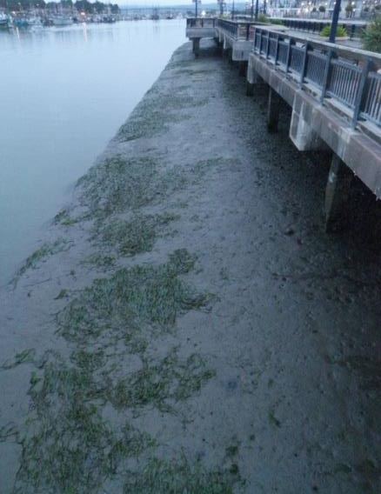
Surveying Considerations
Scale of Project
Depth distribution of eelgrass
Mapping accuracy relative to accepted standards
(ultimate goal:5% max error, CEMP)
Importance of detailed habitat maps:
Getting the impact assessment right the first time
Setting appropriate mitigation targets*
Evaluating the outcome of mitigation/restoration actions**
Identifying opportunities for mitigation
*Avoid under or over-estimating project-related impacts
** Potential mitigation actions (e.g. substrate remediation, piling removal, dredge
cut transplanting) in close proximity to or located within existing eelgrass habitat
Notes:
In a system like Humboldt Bay, it’s going to be very important to apply the right tools in order to get both the impact assessment and mitigation targets correct

Slide 19
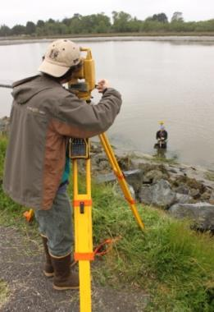
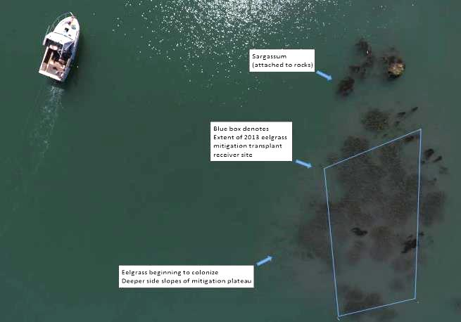
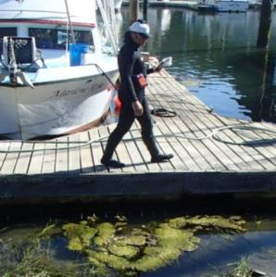
Current & Emerging Approaches to Eelgrass Habitat Assessment
Electronic total station
Intertidal:
(Current) Differential GPS or Electronic Total Station-manual bed delineation suitable for small shoreline projects
(Emerging) Low altitude aerial imagery/photogrammetry: Unprecedented level of accuracy, ideal for small-large scale projects. Ground-based (pole camera), balloon, or UAV platforms. Archivable ‘snapshot’ of habitat conditions and project context
Low-altitude orthomosaic
Sub-meter GPS

Slide 20
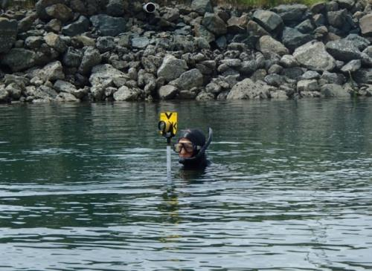
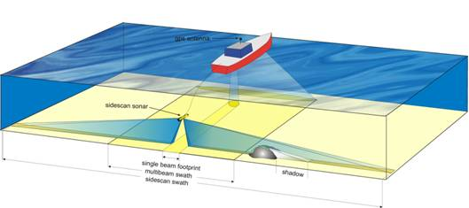
Eelgrass Habitat Assessment (cont)
Subtidal:
Diver transects and bed delineation w/surface support GPS/Total Station
Suitable for very small areas, confirmation of max depth distribution. Drawbacks-high inherent variability, relatively coarse-scale map resolution and overall bed characterization.
Sidescan/Interferometric Sidescan Sonar
Suitable for small-large scale projects, cost-effective, accurate and repeatable, preferred technique for any projects likely to impact subtidal eelgrass
Image: OzCoasts Habitat Mapping

Slide 21
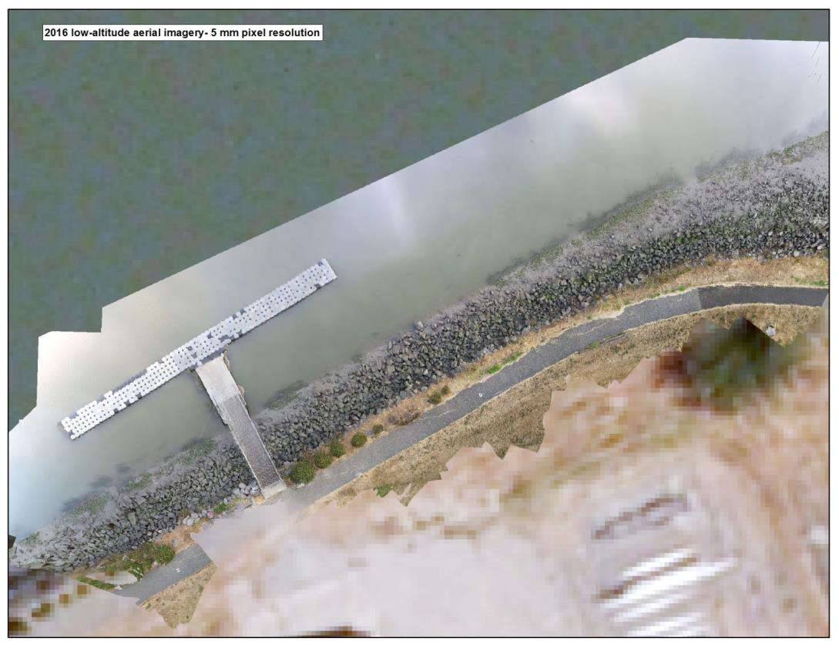
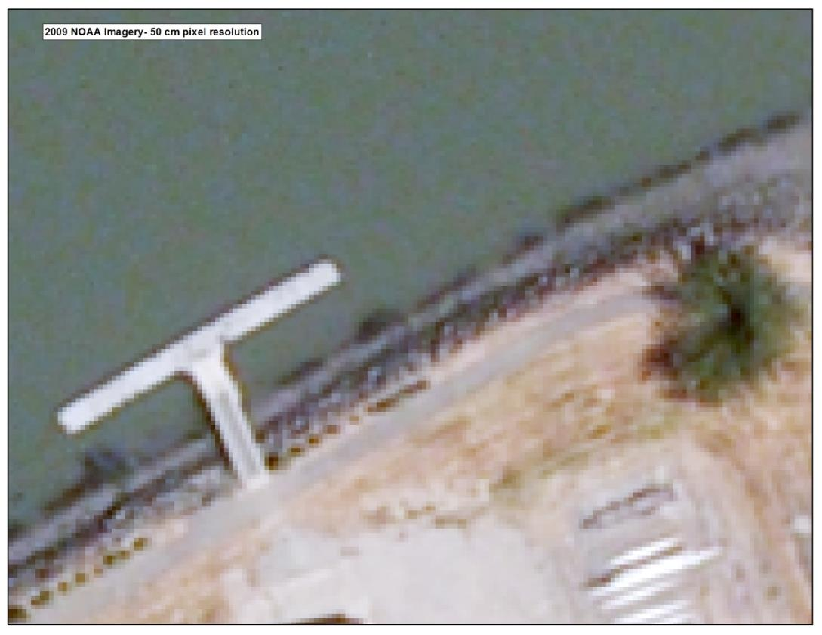
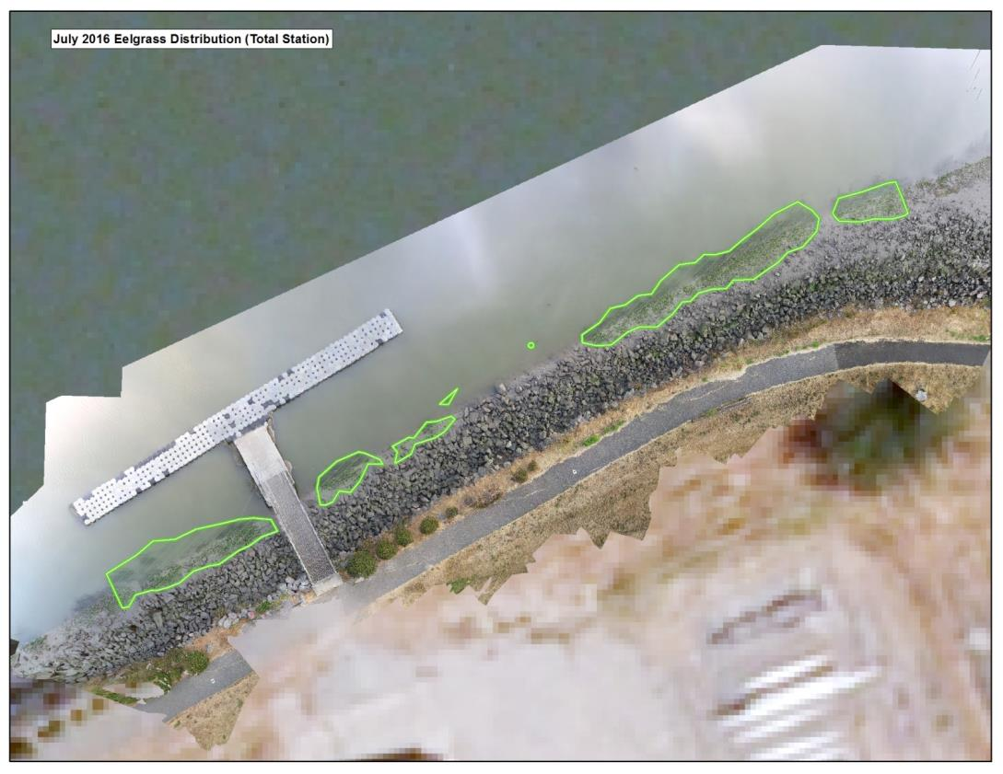

Intertidal Eelgrass Habitat Assessment
(Eureka Waterfront)
Notes:
We are currently taking advantage of existing monitoring projects to calibrate our photogrammetric surveying techniques because it provides a good opportunity to cross-validate with existing techniques

Slide 22
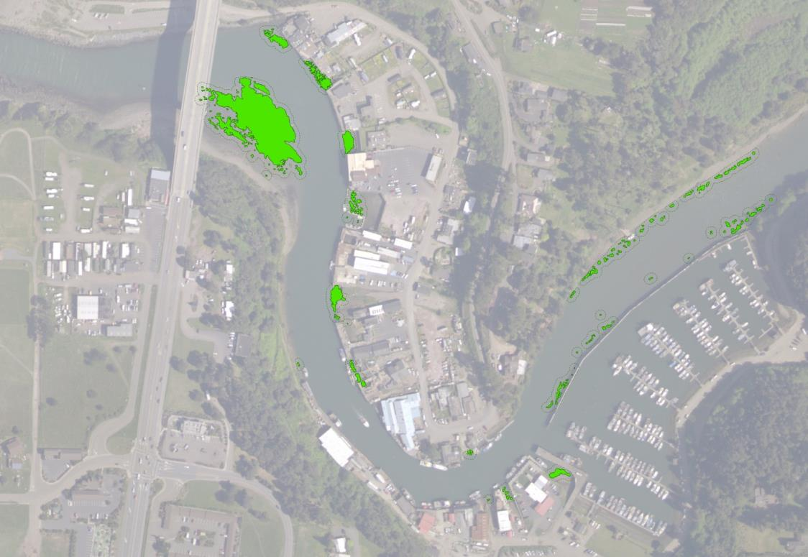
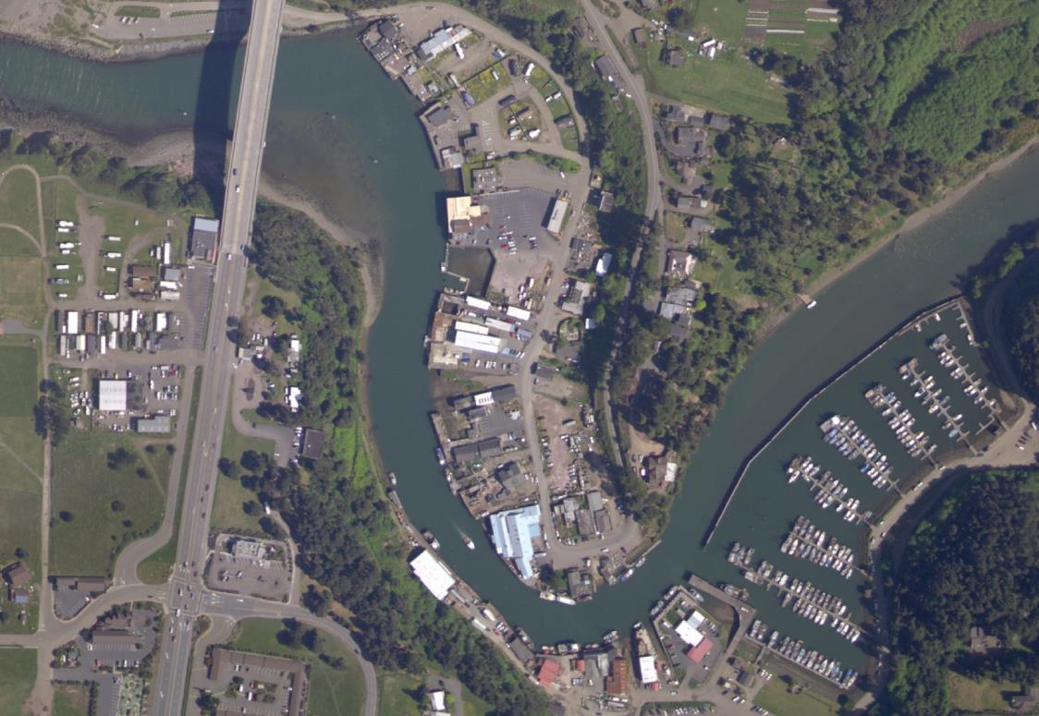
Subtidal Habitat Assessment example (Noyo Harbor)
September 2016 Eelgrass Distribution
Imagery: NOAA 2012
Notes:
Less than1.5 acres of eelgrass in over a mile of channel in Noyo. Much of it subtidal-hydroacoustic surveying is the right tool for this application.

Slide 23
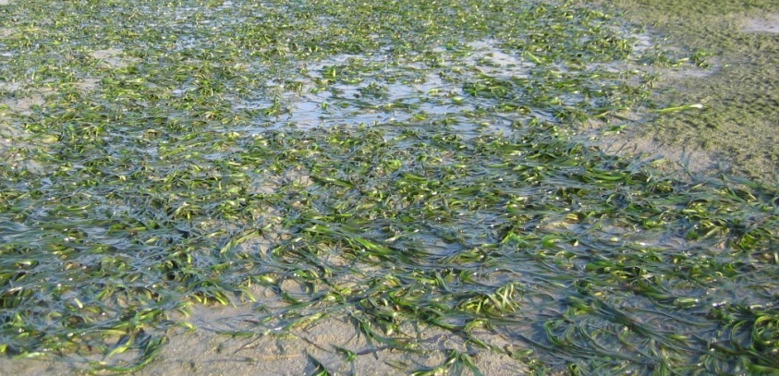
Habitat Assessment - Long Term Monitoring
Understanding system dynamics
Context for impacts relative to eelgrass habitat variability at the Bay scale
Critical for long-term conservation of eelgrass in Humboldt Bay
Tracking the effects of climate change, sea level rise and other drivers of habitat distribution
Majority of Humboldt Bay eelgrass is intertidal-Use of emerging imagery tools with traditional transect-based habitat characterization = powerful and cost-effective means of establishing robust long-term monitoring program

Slide 24
Eelgrass Restoration and Mitigation Opportunities
History of past mitigation in Humboldt Bay-site suitability is critical to successful mitigation
Poor historic performance- high up-front mitigation transplanting ratios
(CEMP; 4.82:1) Compounds the challenges and costs of mitigation
Need to think outside the box to find creative solutions for eelgrass mitigation
Opportunities exist at the site level, but need to be careful that mitigation and conservation efforts within the focus area of the plan don’t conflict with other bay uses
Argues for a system approach to plan development- Promote eelgrass restoration/mitigation outside the focal area of the plan

Slide 25
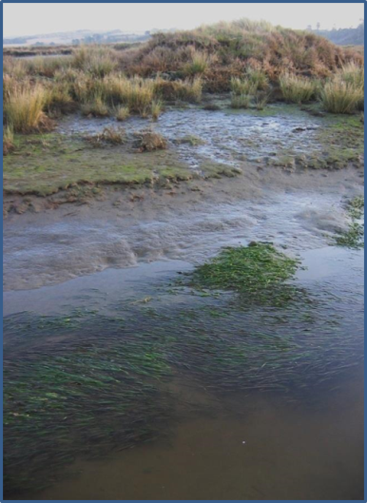
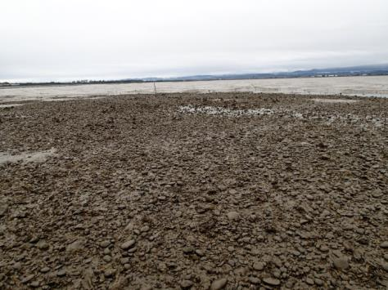
Eelgrass Restoration and Mitigation Opportunities (cont.)
Piling/decking removal for very small project impacts in the Plan Focus area
For larger scale impacts, need to identify opportunities at the system scale to restore/mitigate eelgrass habitat
Salt Marsh restoration in former tidelands-increases tidal prism – facilitates eelgrass expansion in tidal channel network
Substrate remediation- Shell hash/cobble –legacy of historic bottom culture practices, continues to displace eelgrass from historic habitat

Slide 26
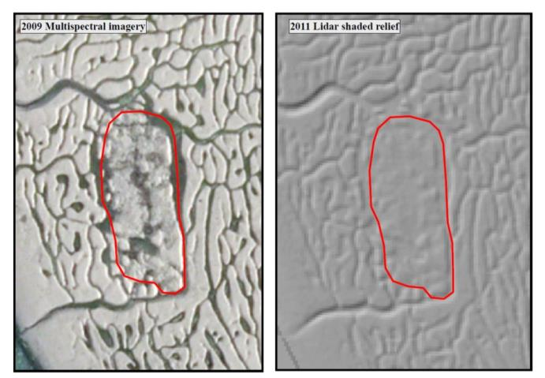
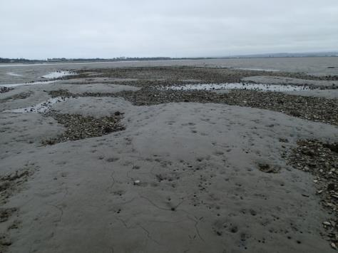
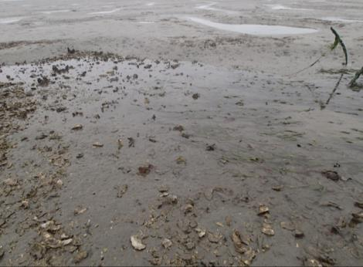
Substrate Remediation to Restore Historic Eelgrass Habitat
North Bay- Legacy bottom hardening site
Outside current mariculture operations
Approximately 1/3 -1/2 acre of eelgrass restoration capacity-patchy eelgrass surrounds site
Landowner receptive to conservation easement
Other similar opportunities exist-Challenges include: ownership and existing management

Slide 27
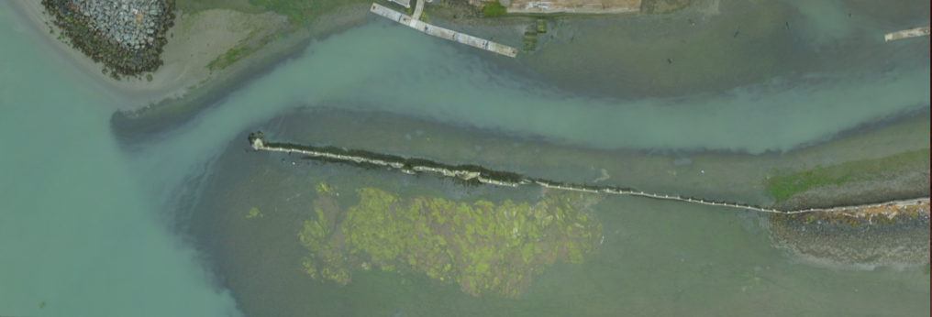
Progress to date
Background research on past eelgrass mitigation efforts in Humboldt Bay (successes, failures, lessons learned)
Eelgrass mitigation status, future maintenance dredging needs- Woodley Island and Eureka Public Marinas
Preliminary Project Focus Area/Plan scoping
QA Plan development underway with EPA
Preliminary research on eelgrass restoration/mitigation opportunities

Slide 28
Proposed Project Timeline and Milestones
Project Partner meeting Scheduling ~6 week intervals with final public workshop in May (assuming finalized plan)
Project Milestone | Tentative Schedule
Initial Public Workshop | October 20, 2016
1st Project Partner Meeting | October 20, 2016
2nd Project Partner Meeting | Mid November/early December 2016
3rd Project Partner Meeting | Mid January 2016
Plan Draft #1 | Mid February 2017
4th Project Partner Meeting | Early March 2017
Administrative Plan Draft #2 | Early April 2017
5th Project Partner Meeting | Mid April 2017
Final Plan Draft #3 | Early May 2017
Final Public Workshop and Plan Presentation | Late May 2017

Slide 29
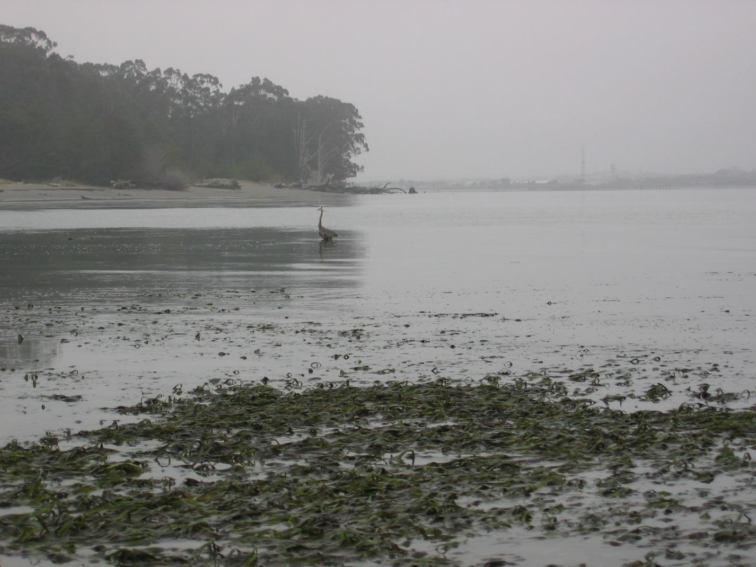
Questions?

